Slide 1

Manish J. Thapa
20.05.2021
Project 1 – Grover’s algorithm

Slide 2
Grover’s algorithm
Compare classical and quantum algorithm
0 0 0 0 1 0 0 0 0
1
N

Slide 3
Grover’s algorithm
Compare classical and quantum algorithm
Let us understand classical first!
0 0 0 0 1 0 0 0 0

Slide 4
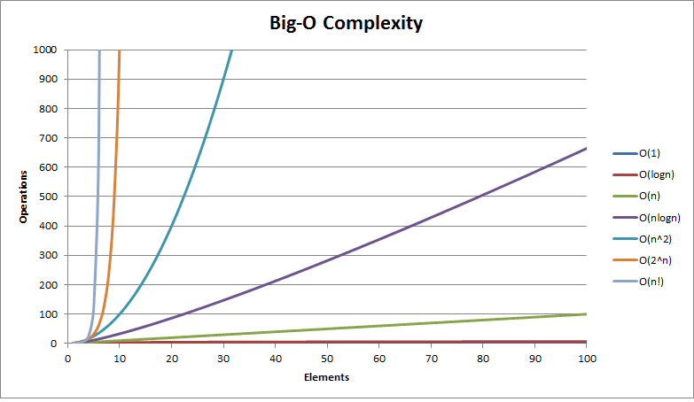
Query complexity
graph credits http://bigocheatsheet.com/
What is a query complexity?
Imagine you have a prime number encoded in ‘n’ bits. How long does it take for your
classical algorithm to find its prime factors?
We parameterize computational complexity using ‘n’. Does it run in poly(n) time?
Or in something like O(2^n)?
n
2
0101
2
t - number of steps is circuit depth
s - number of resources (or qubits) is circuit width
20
0101110
2,5
Number of quantum operations (except those that are executed in parallel) relate to the time the algorithm takes to run

Slide 5
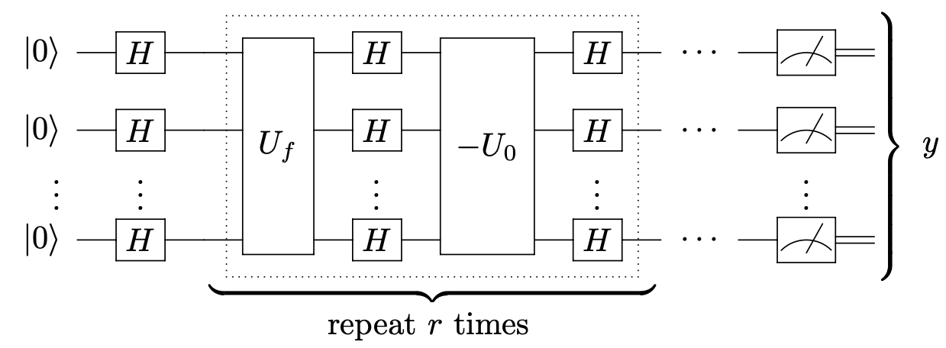
Quantum circuit
t - number of steps is circuit depth
s - number of resources (or qubits) is circuit width
- R_+

Slide 6


Linearity of quantum mechanics
Unitaries are applied in parallel:
Check for example, if you apply the middle-matrix to a superposition of states of n qubits
how does it look?

Slide 7
Thank You Visit us at www.onequantum.org Don’t forget about the virtual cocktail party happening in few minutes!

